Slide 1
Toyota Innovation Challenge
By: Yash Jagirdar, Rohan Nair, Leo Tian, Christopher Yu

Slide 2
BACKGROUND
The goal is to develop an automated solution for installing round stickers (plug plates) on vehicle body holes. This system reduces road noise and protects against water damage. It works by peeling stickers with a feeder system and placing them on body holes using a robot with a specialized applicator. The robot uses a vision system to identify hole centers and ensures precise sticker placement.

Slide 3
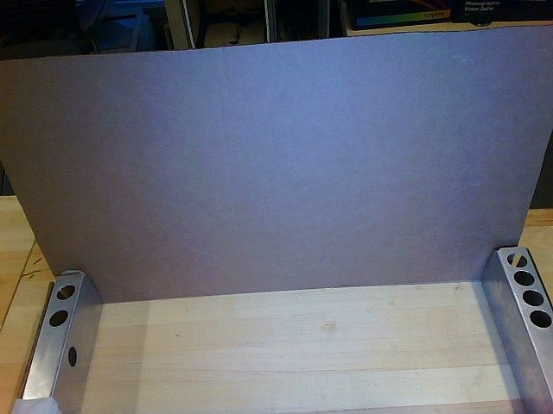
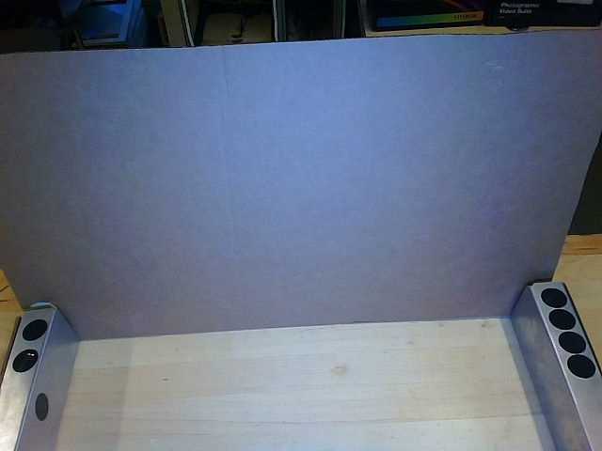
CURRENT CONDITION
A member of the team manually applies stickers over the body hole, followed by a visual examination to ensure their proper placement.
1
2

Slide 4

TARGET CONDITION
Successful Outcomes
Outcome: Distinguish uncovered hole from fully covered hole
Test environment: unpainted sheet metal, black sticker
Outcome: Distinguish uncovered holes from fully covered holes. Can ignore vertical hole on left side Test environment: Fixed camera, unpainted sheet metal, black sticker
Outcome: Identify uncovered and partially covered holes from fully covered holes.
Test environment: Fixed camera, unpainted sheet metal, black sticker
Outcome: Identify uncovered and partially covered holes from fully
covered holes. Must include vertical hole on left side.
Test environment: moveable camera and lighting; red or white
painted vehicle

Slide 5
PROBLEM ANALYSIS
Our solution is required to:
Confirm the presence of all 7 stickers applied by the robot
Confirm the body holes are fully covered by the stickers
Confirm that the stickers are flush with the surface (e.g. no wrinkles)
Ensure that the total inspection time for all 7 stickers does not exceed 15 seconds

Slide 6
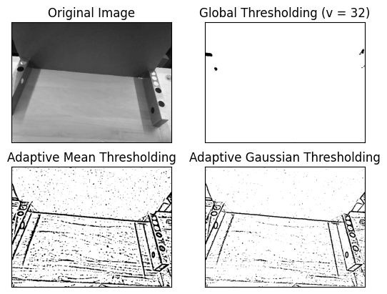
COUNTERMEASURES
At first, we explored with image thresholding to detect black holes and stickers. However, this method was limited to only identifying the areas that had high contrast between them and captured points that weren’t useful
We decided to use computer vision. We were debating if we wanted to use a classical model or deep learning
We took images for our dataset: 25 metal, 25 white, 25 red, 25 black

Slide 7
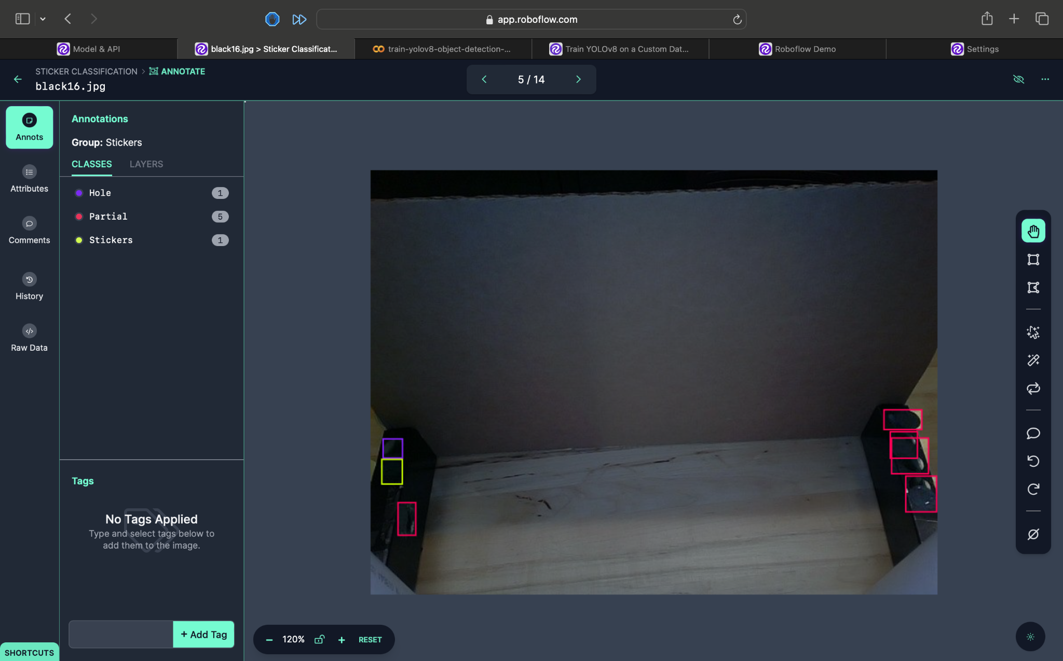
COUNTERMEASURES
Approach was to use an already existing model, then feed images we took to further train the model to suit our needs
Roboflow and Ultralytics Yolo was used to train the model
Used image processing to enhance the model

Slide 8

IMPLEMENTATION
Step 1: Training Data Collection
Ultralytics Asked mentor for help and decided how many images we need
Decided to take 118 images
Used Image Augmentation to increase the number of images to 300, as well as train

Slide 9
IMPLEMENTATION
Step 2: Labeling Training Data
Used Roboflow to label 132 training images
Augmented Images to increase number of training images to 396

Slide 10
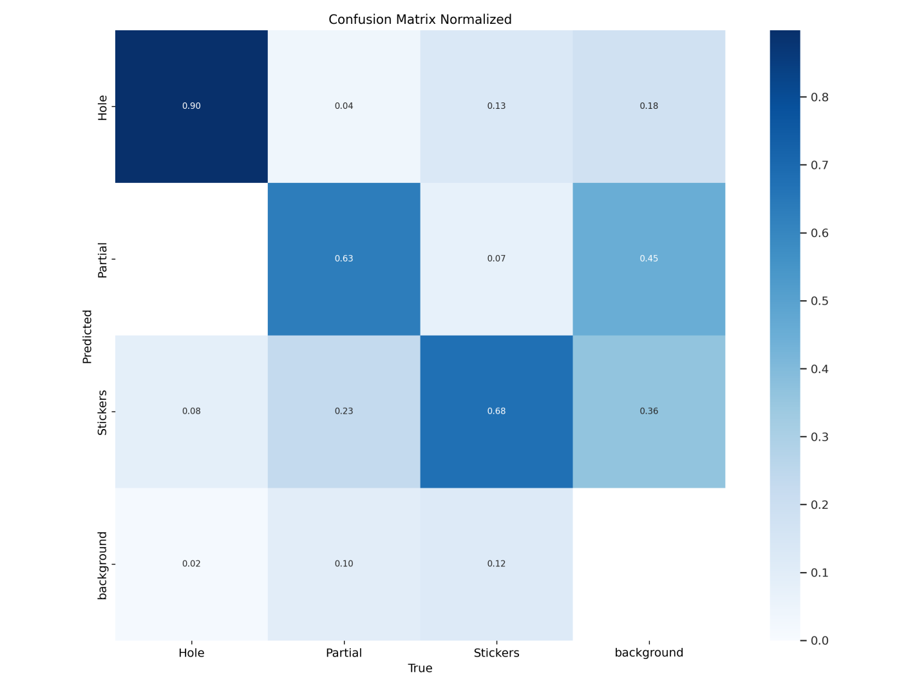
IMPLEMENTATION
Step 3: Training YoloV8 model with our data
Preprocessed images
Auto adjust contrast on each image
Exported data from Roboflow
Transfer learning using Ultralytics
Additional training on pre-trained model

Slide 11
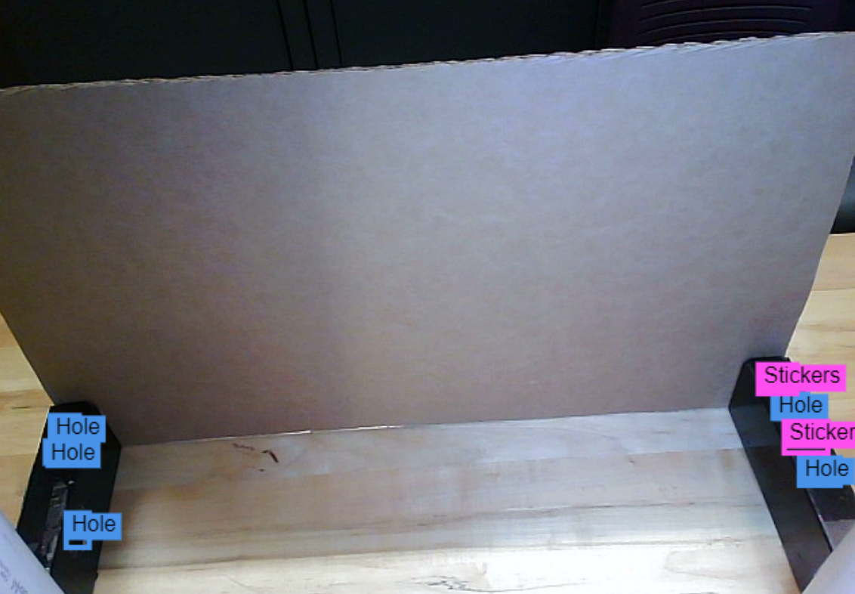
IMPLEMENTATION
Step 4: Integration with videocapture
Fed images from videocapture into trained model
Drew rectangles and labeled objects based on model output

Slide 12
EVALUATE RESULTS AND PROCESS
If we had more time we would:
Use a larger training dataset
Customise model to include more input depth
Take other kinds of data like depth data
Be able to load both pre-processed and unprocessed data into input layer
Explore more classical methods of image processing in pre-processing

